Slide 1
niCHART U24 Grant
1st Scientific Steering Committee Meeting
May 2023
Introductions: ~10 mins
Overview of the project: 5 mins (Christos Davatzikos)
Overview of the technical organization of the software packaging: 4mins (Guray Erus)
sMRI module: 3mins (Guray Erus)
rsfMRI and dMRI preprocessing modules: 5mins (Ted Satterthwaite)
rsfMRI NMF and other related modules: 3mins (Yong Fan)
Harmonization module: 3mins (Haochang Shou and Taki Shinohara)
Dissemination plans: 5mins (Ilya Nasrallah and Dan Wolf)
Feedback from the committee: ~22mins

Slide 2
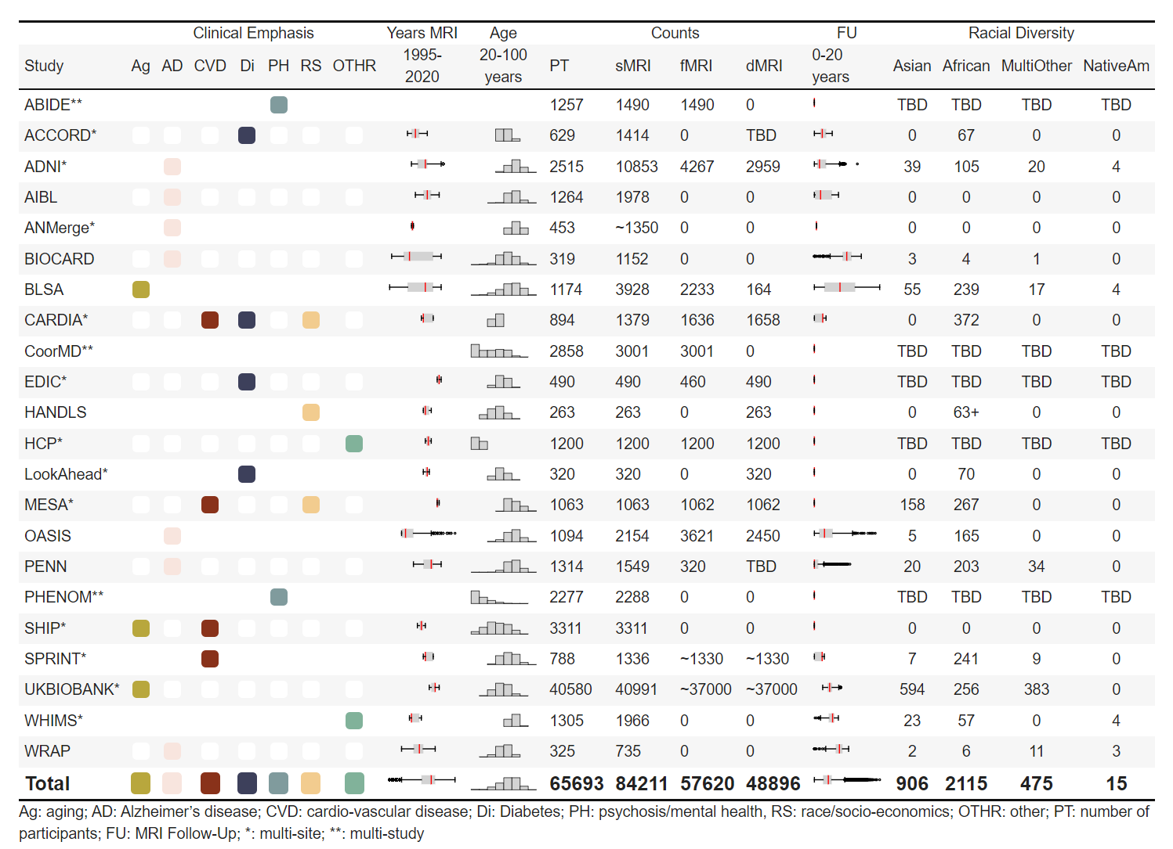
Leadership or Co-leadership in a number of international consortia
+ Public Datasets
Projected total N > 100,000 scans + High diversity of cohorts, diseases, scanners

Slide 3
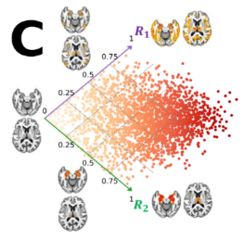

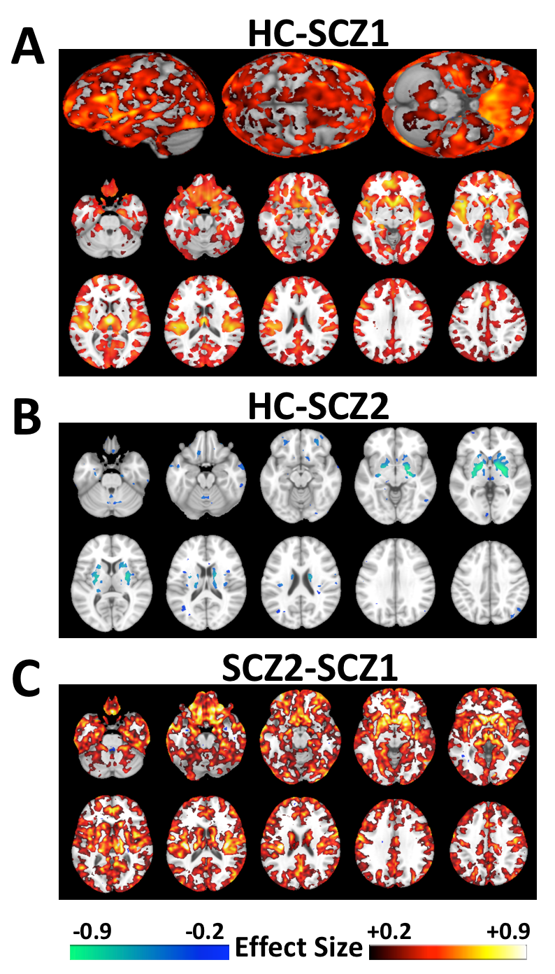
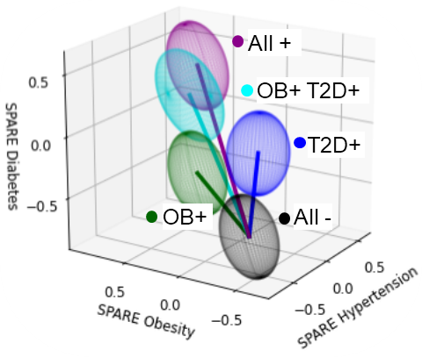
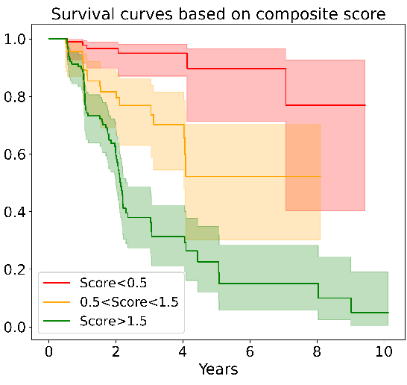
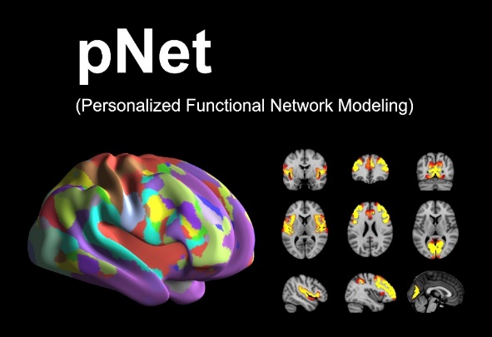
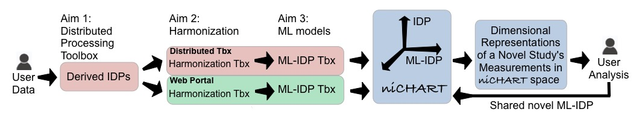
Emphasis on Machine Learning-Derived Imaging Signatures
Imaging Signatures of Cardiometabolic Risk Factors
Schizophrenia Subtypes
JAMA Psychiatry
Molecular Psychiatry
Am. J. Psychiatry
Brain
AD&D
Nature Communications
HBM, Neuroimage
PNAS, …

Slide 4
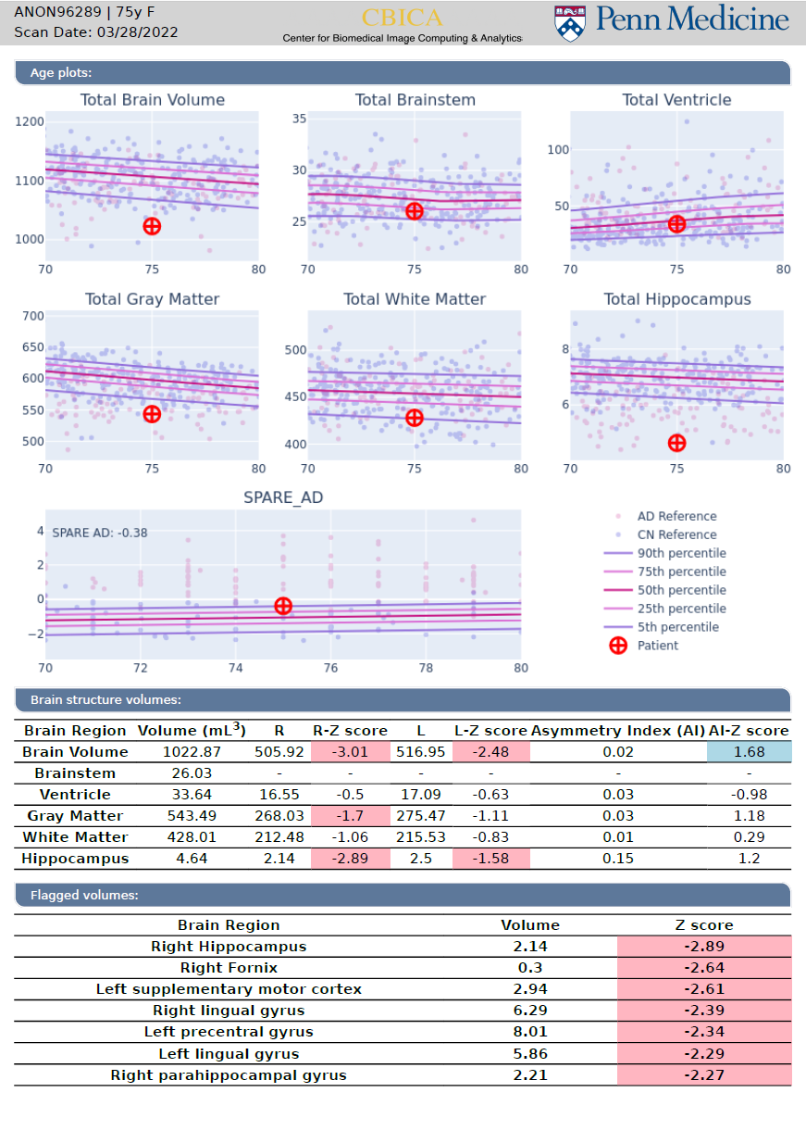
niCHART

Slide 5
Specific Aims
Aim 1a, b, c: sMRI, rsfMRI, dMRI preprocessing toolboxes
Aim 2: Harmonization toolbox
Aim 3: Standardize and enrich ML-based imaging signatures and models
Aim 4: Standalone niCHART software, and web-based implementation of preprocessing pipelines
Aim 5: Dissemination, continuous enrichment, distribution. Training and support via online and in-person sessions.

